Slide 1
Reframing Readiness: How Reconsidering Cognitive Screening Became a Pivot Toward Occupational Justice in Power Mobility
Richelle Gray, PhD, OTD, OTR/L, ATP/SMS, CDP
October 16, 2026

Slide 2
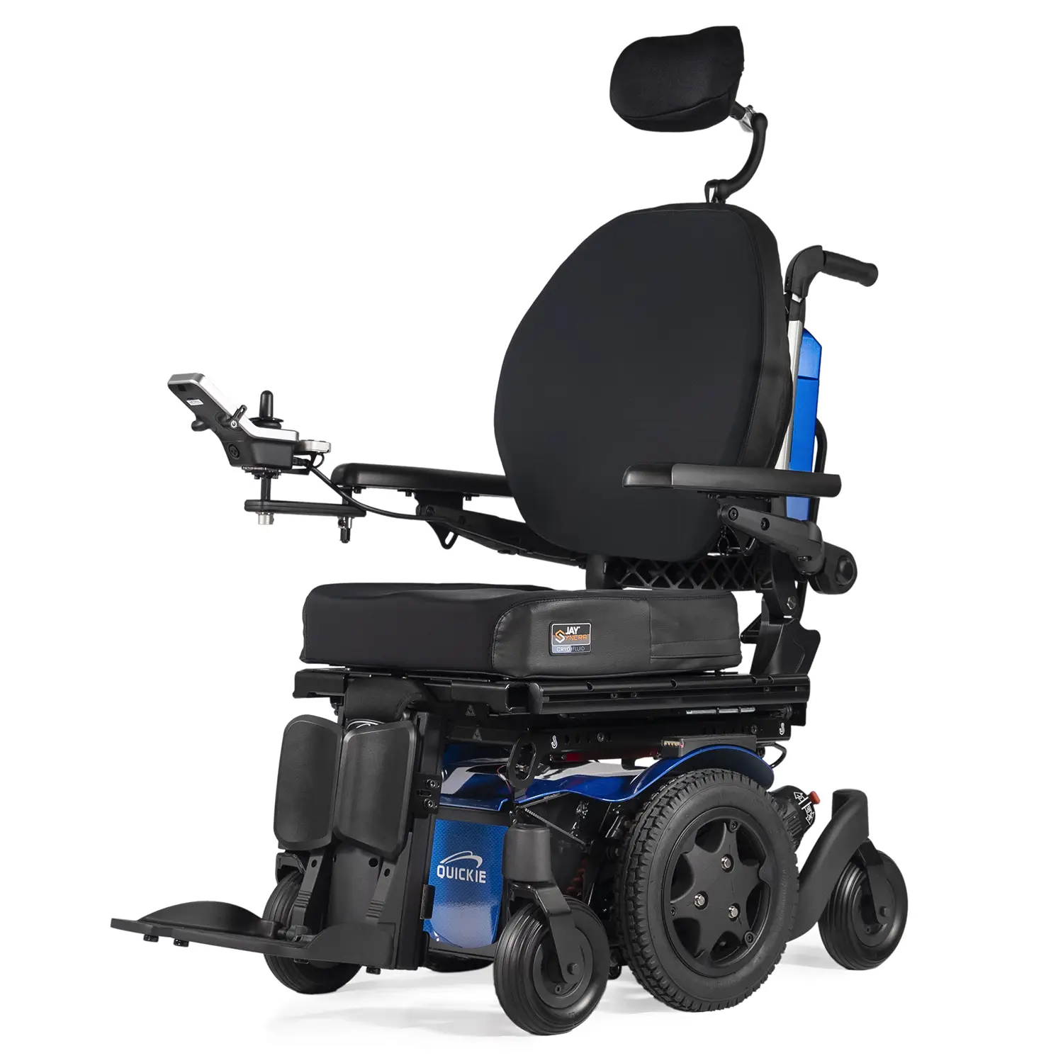
Participants will differentiate between the use of cognitive tools as gatekeeping measures versus contextual data within power mobility decision-making.
Participants will identify at least 3 factors that interact with cognitive screening results to influence power mobility performance.
Participants will identify how cognitive screening results can be integrated into a custom seating evaluation to support, rather than restrict, participation in power mobility.

Slide 3

Richelle Gray, PhD, OTD, OTR/L, ATP/SMS, CDP
Assistant Professor, Division of Occupational Therapy
West Virginia University
Assistive technology, seating, and mobility specialist
Founder and clinician, RNI Seating Clinic
Researcher in power mobility and cognition
Advocate for participation-focused mobility assessment
Notes:
My clinical practice and research focus on seating and mobility evaluation, particularly the factors that support successful power mobility use. Over time, both my clinical experience and research findings challenged my assumptions about the role cognitive screening should play in determining power mobility readiness. Today, I'd like to share how that shift in thinking has influenced my practice and may help us reconsider how we approach power mobility decision-making

Slide 4
When Does a Cognitive Score Become a Barrier?
Cognitive screens are commonly used in seating evaluations.
Scores may be used to determine readiness for power mobility.
Some individuals never receive a power mobility trial because of screening results.
This can create barriers to participation.

Slide 5
My Pivot Point
Early practice: cognitive screening scores heavily influenced my recommendations.
Clinical experience challenged my assumptions.
Some individuals performed better than their screening scores suggested.
Research reinforced a broader approach to decision-making.
Result: Cognitive screening became one piece of the puzzle rather than the decision itself.

Slide 6
What Cognitive Screens Actually Tell Us
Cognitive screens can provide information about:
Memory
Attention
Orientation
Executive Functioning
Learning Needs

Slide 7
What Cognitive Screens Do NOT Directly Measure
Power wheelchair performance
Occupational participation
Motivation
Environmental supports
Past experience with powered mobility

Slide 8
Readiness for Power Mobility is Multifactorial
Power Mobility Participation
Cognitive function
Previous experience
Environmental demands
Training opportunities
Physical abilities
Support systems

Slide 9
Putting the Assumption to the Test
Gray, R. L., Hay, C. C., Pickens, N. D., & Mitchell, K. (2026). The association of cognitive screen scores and previous power mobility device experience on the Power-mobility Indoor Driving Assessment. Disability and Rehabilitation: Assistive Technology, 21(4), 1236-1247. https://doi.org/10.1080/17483107.2025.2586224
Study Snapshot
33 Power Mobility Users
📍 7 Residential Care Facilities in West Virginia
👤 Ages 67-95 years
🦽 Average PMD experience: 5.9 years
🧠 88% demonstrated cognitive impairment on screening
🏥 Long-term care, assisted living, and independent living settings

Slide 10
What Surprised Us?
❌ Cognitive impairment did not automatically result in poor power mobility performance.
✅ Many individuals with cognitive impairment demonstrated safe and effective power mobility skills.
✅ Previous experience appeared to matter more than cognitive screening scores alone.
✅ Readiness for power mobility is more complex than a single cognitive score.
Bottom line:
A cognitive screening score alone cannot determine whether an individual can use power mobility safely and effectively

Slide 11
Take-Home Message
Cognitive screening should inform power mobility decisions, not determine eligibility for power mobility.
Then:
Use screening results as contextual data.
Consider occupational performance.
Trial when appropriate.
Promote participation and occupational justice.

Slide 12
References
Best, K. L., Smith, E. M., Pellichero, A., Sorita, E., Archambault, P. S., Kenyon, L., Lamontagne, M., Lemelin, B., Kirby, R. L., & Routhier, F. (2021). International research priorities on the role of cognition in power mobility device use: In pursuit of informed clinical practices and knowledge translation. Assistive Technology, 35(2), 119-126. https://doi.org/10.1080/10400435.2021.1956638
Dickson, N. C., Gohil, A. R., & Unsworth, C. A. (2023). Powered mobility device use in residential aged care: A retrospective audit of incidents and injuries. BMC Geriatrics, 23(1), Article 363. https://doi.org/10.1186/s12877-023-04073-z
Gray, R. L., Hay, C. C., Pickens, N. D., & Mitchell, K. (2026). The association of cognitive screen scores and previous power mobility device experience on the Power-mobility Indoor Driving Assessment. Disability and Rehabilitation: Assistive Technology, 21(4), 1236-1247. https://doi.org/10.1080/17483107.2025.2586224
Pellichero, A., Best, K., Leblond, J., Coignard, P., Sorita, E., & Routhier, F. (2021). Relationships between cognitive functioning and power wheelchair performance, confidence, and life-space mobility among experienced power wheelchair users: An exploratory study. Journal of Rehabilitation Medicine, 53(9).
https://doi.org/10.2340/16501977-2869

Slide 14
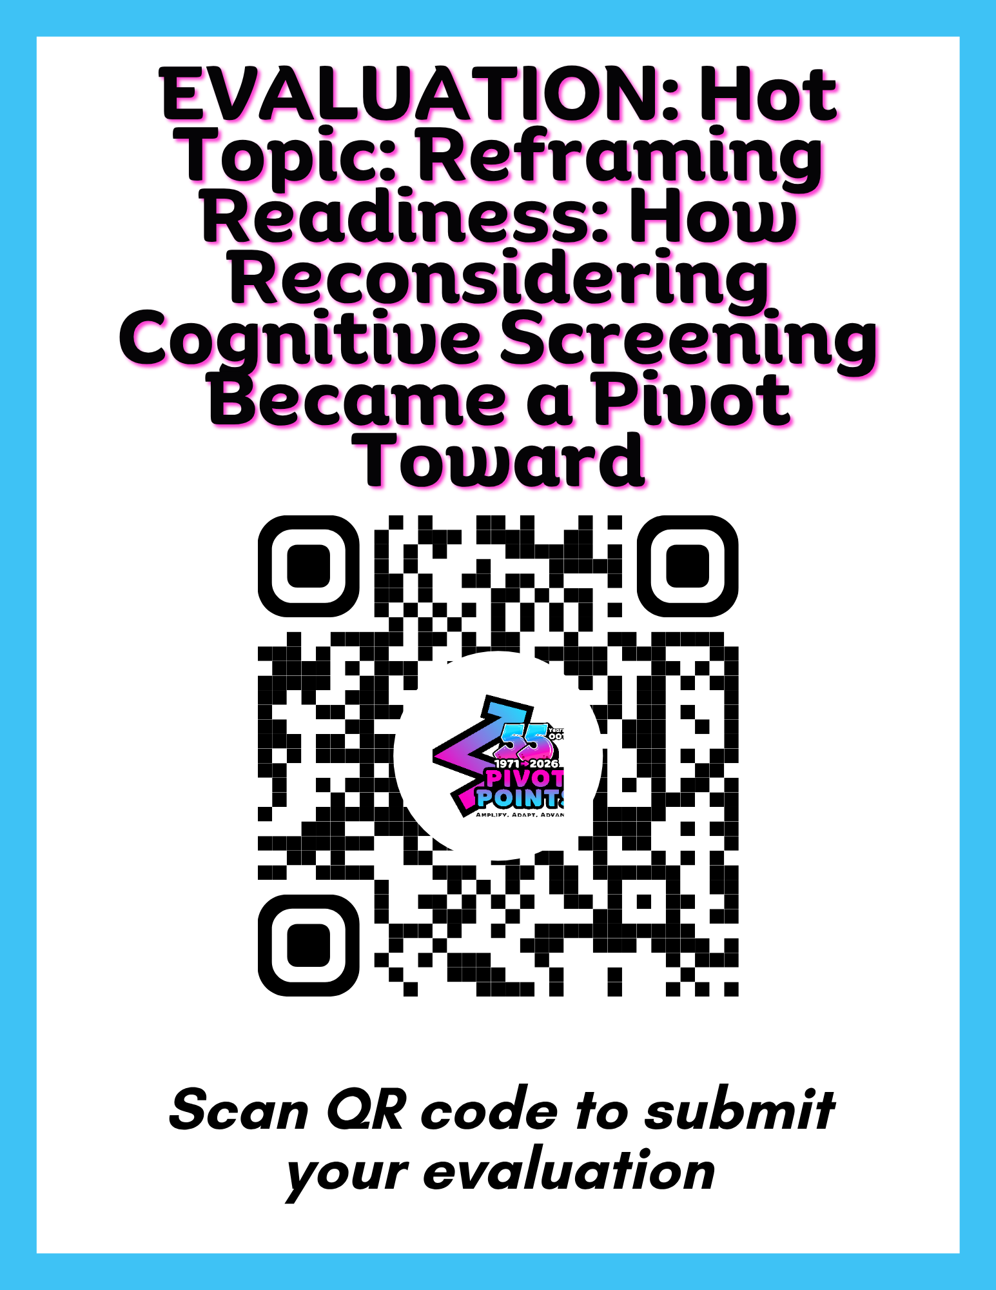
Richelle Gray
Richelle.gray@hsc.wvu.edu

